Slide 1
Accessing Data with Spring Boot and H2

Slide 2

Overview
Data access
Benefits of Spring with JPA Default configurations Querying using repositories

Slide 3
H2 Database

Slide 4




H2 Database
Open source database written in Java
In-memory database
Good for POCs, dev environments, simple database
Administer via the H2 console

Slide 5
<dependency>
<groupId>com.h2database</groupId>
<artifactId>h2</artifactId>
<scope>runtime</scope>
</dependency>
H2 Dependency
Auto-configures H2 related properties

Slide 6

H2 Defaults
spring.datasource.url=jdbc:h2:mem:testdb
spring.datasource.driverClassName=org.h2.Driver spring.datasource.username=sa spring.datasource.password= spring.h2.console.enabled=false

Slide 7
Override Defaults
spring.h2.console.enabled=true
spring.h2.console.path=/h2 spring.datasource.url=jdbc:h2:mem:bugtracker

Slide 8
ORM with JPA

Slide 9


ORM with JPA
Spring Data JPA
Java Persistence API (JPA)
Java Database Connectivity (JDBC)

Slide 10
<dependency>
<groupId>org.springframework.boot</groupId>
<artifactId>spring-boot-starter-data-jpa</artifactId>
</dependency>
Spring Data
Hibernate, Spring Data JPA, Spring ORM

Slide 11
Entities

Slide 12
Entities
package com.pluralsight.entity;
import javax.persistence.*; @Entity
public class Application { @Id
@GeneratedValue(strategy = GenerationType.AUTO) @Column(name="application_id")
private Integer id;
@Column(name = "app_name", nullable = false) private String name;

Slide 13

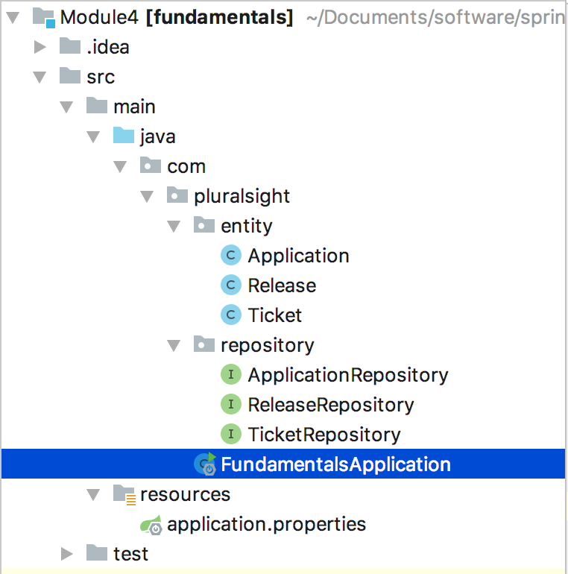
Entity Scanning

Slide 14

Demo
H2 database access
Spring Data JPA Entity Scanning Repositories

Slide 15
H2 data access using Spring Boot
ORM with JPA
Summary
Benefits of Spring with JPA
Entities
Simple queries with Repositories

